Slide 1
Recommendation for business by area

Slide 2
Objective
To see how similar and dissimilar is Brooklyn , NewYork to Etobicoke, Toronto.
These are two cities in the similar climatic conditions in the world and it will be interesting to see how different are the venues in counts from both.

Slide 3
Data Sources
New York data are from a json file that was provided during our course, and Toronto data are from table in Wikipedia page which contains list of postcodes in Canada. These data was used with Foursquare API for finding data about restaurants in different neighborhoods and clustering them.

Slide 4
Data Cleaning
For New York data, after loading the json file which contains data about of 306 neighborhoods, some features are extracted from the json file such as Borough, Neighborhood, Latitude, and longitude. Then, a for loop is used for filling the neighborhood data frame. Now neighborhood data frame can be used with geocoder to find the latitude and longitudes.
For Toronto data, after scraping postcodes from list of postcodes of Canada from Wikipedia page, all boroughs and neighborhoods are cleaned up by removing all not assigned values from the table. Also, geocoder library was used for finding the latitude and longitude of neighborhoods in Toronto

Slide 5
Libraries imported
• numpy to handle data in form of vectors which fasten the computations
• pandas to deal with data frames
• json library to handle json files
• requests library to handle requests
• matplotlib for plotting charts
• k-means for clustering
• folium for map rendering

Slide 6
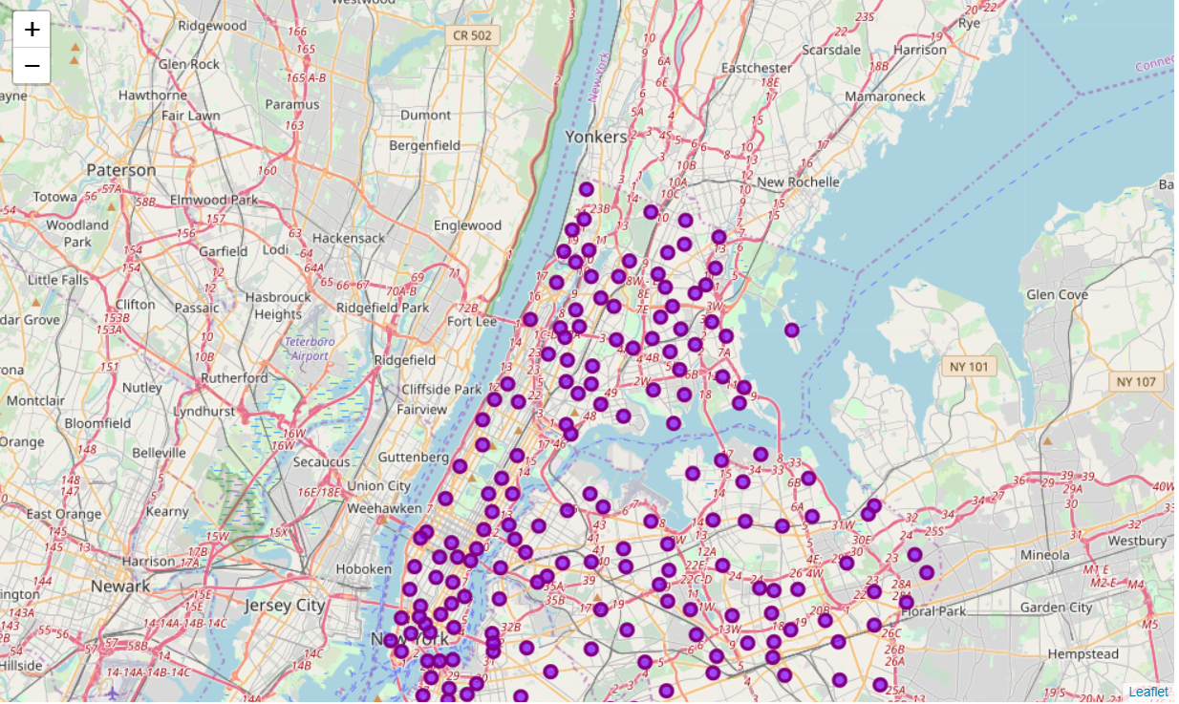
Neighborhoods in NewYork
There were in total of 306 neighborhood in NewYork

Slide 7
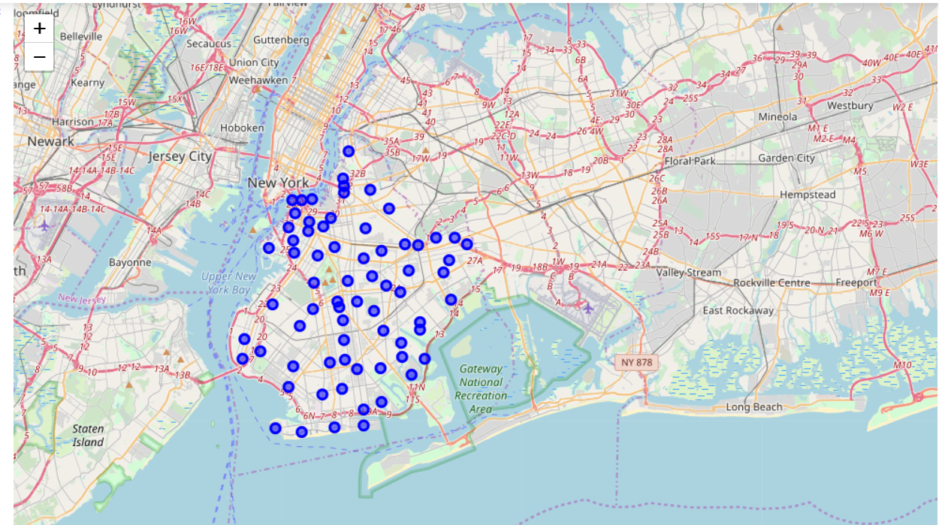
Brooklyn
This map shows all the boroughs for Brooklyn Neighborhood.

Slide 8
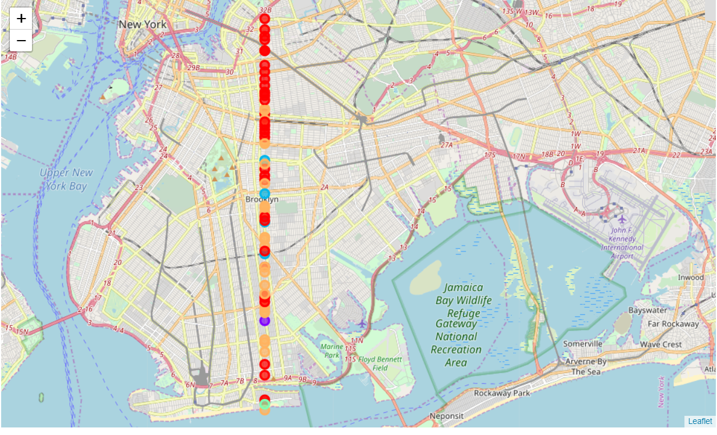
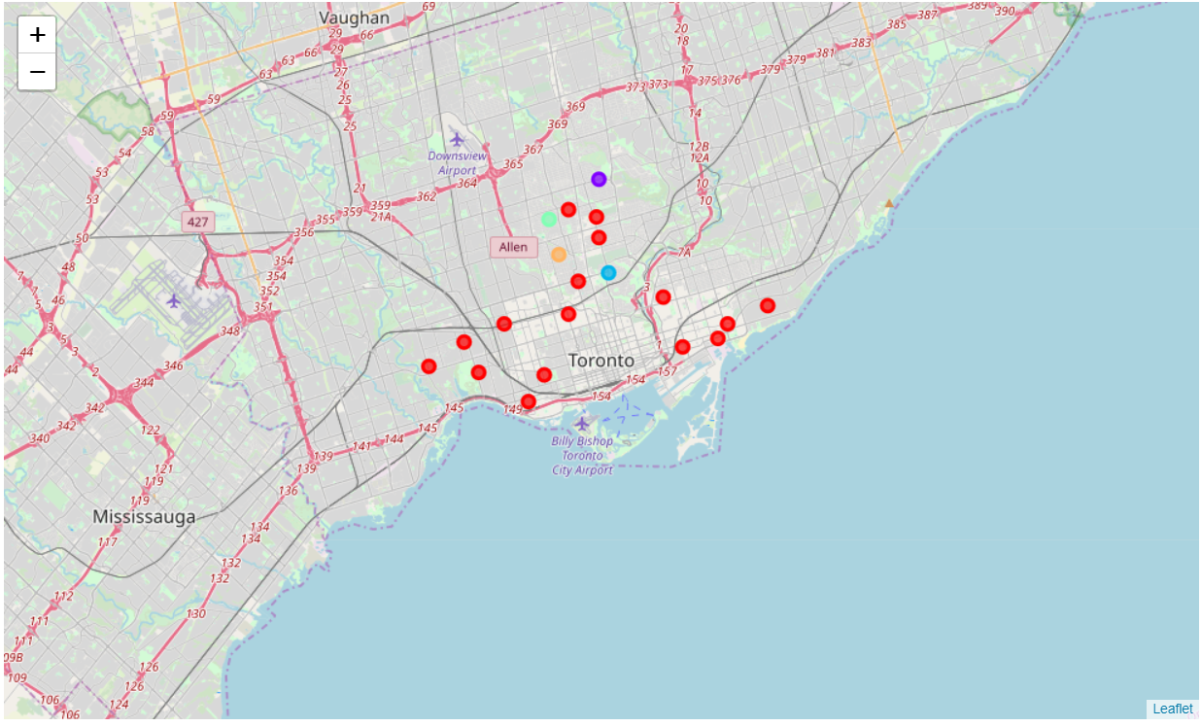
Clustering Comaprison
BROOKLYN VENUES CLUSTERD VS ETOBICOKE CLUSTERED

